Slide 1
Agenda
Decision Tree
· Intro
· Concept
· Entropy
· Information Gain
· Forward Pruning
· Backward Pruning
· Implementation of C5.0
Boosting & Bagging
· Intro
· What is Bagging and Boosting
· Comparing the results of Boosting and single model
· Parameters in Boosting
Bias & Variance

Slide 2

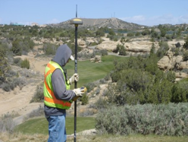
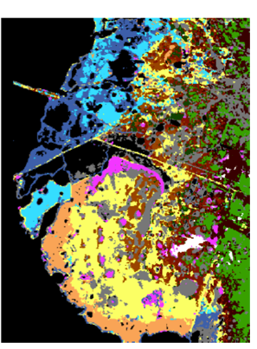
Workflow- Data to Deployment
Collect Raw (Input) Data
Collect (Output) Ground Truth!
Engineer “Predictive” features
“Train” an ML “Model”
Choose Model type & complexity
Deploy Model. Make Predictions on Unlabeled data
Evaluate, Iterate, Improve Model

Slide 3
Data

Slide 4
Workflow From Data to Decisions…
Insights
Features
Domain
Knowledge
Data
Models
Feedback
Predictions
Decision
Business Objectives
Business Constraints

Slide 5
Dating the Data!
Insights
Features
Domain
Knowledge
Data
Models
Feedback
Predictions
Decision
Business Objectives
Business Constraints

Slide 6
Data Nuances
FEATURE NOISE – value may not be accurate
Sensor Malfunctioning, Sensor Biased, Sensor Resolution,…
Call center notes, Transcription errors, Data entry errors
Comments → Tweets →Blogs → News → Scientific Papers
MISSING FEATURES – some feature values might be missing
Sensor went down, Communication/Storage failure, Human error
NON-NORMAL FEATURE DISTRIBUTIONS
Exponential, log-normal distributions are more common than normal
Taking log of features helps
HETEREGONEOUS FEATURES - ranges, scales, distributions.
E.g. Age, Income, Temperature, RBC Counts, Blood Pressure,…
MULTI-MODALITY FEATURES
Mix of numeric, symbolic, series, text, and image PER data point!

Slide 7
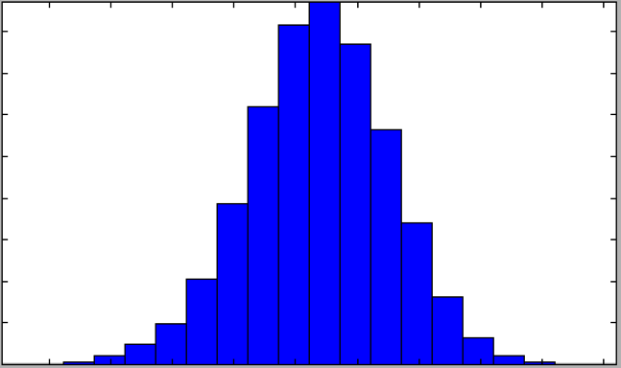
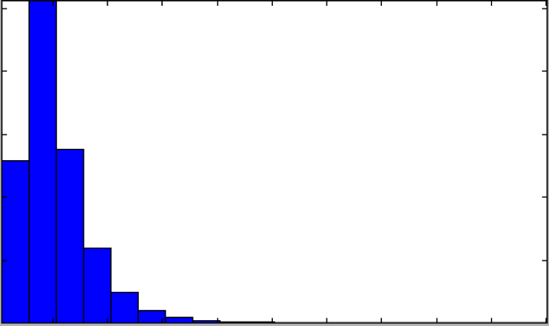
Not normal distributions!
log(feature)
feature

Slide 8
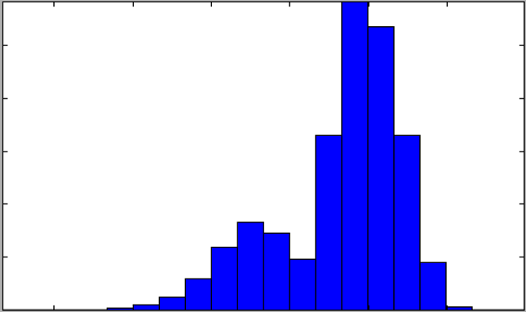
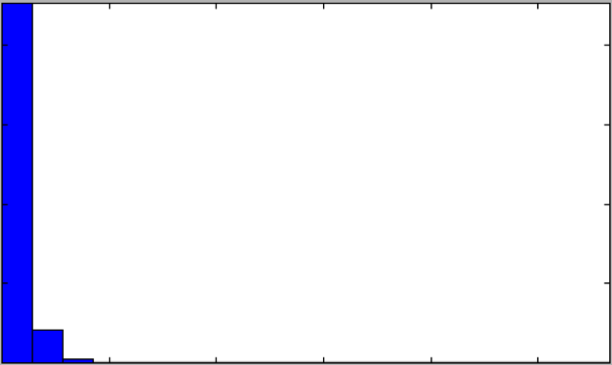
Hidden Treasures!
log(feature)
feature

Slide 9
Feature Engineering

Slide 10
Feature Engineering
Collect Raw (Input) Data
Collect (Output) Ground Truth!
Engineer “Predictive” features
“Train” an ML “Model”
Choose Model type & complexity
Deploy Model. Make Predictions on Unlabeled data
Evaluate, Iterate, Improve Model

Slide 11
Two Mindsets to Modeling
Model-Centric
Throw all features in!
Have enough data
Build Complex models
Feature-centric
Carefully craft features
Use Domain Knowledge
Build Simpler Models
Simple Features
Complex Model
Complex
Features
Simple
Model
The Law of Conservation of Complexity

Slide 12
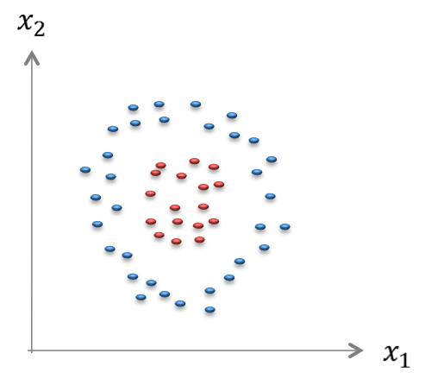
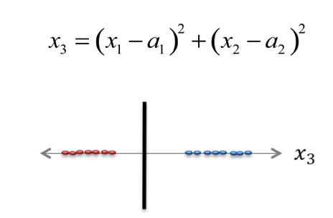
Distribute Complexity Fairly
Simple Features
Complex Model
Complex
Features
Simple
Model

Slide 13

Engineer Features that make sense!
Raw Input
Time of current trans.
Place of current trans.
Time of prev. trans.
Place of prev. trans.
Derived Feature - 1
Distance(Prev→Current)
TimeLag(Prev→Current)
Derived Feature - 2
Velocity(Prev→Current)

Slide 14
Feature Engineering
Collect Raw (Input) Data
Collect (Output) Ground Truth!
Engineer “Predictive” features
“Train” an ML “Model”
Choose Model type & complexity
Deploy Model. Make Predictions on Unlabeled data
Evaluate, Iterate, Improve Model

Slide 15
What is Classification?
PARTITIONING the (FEATURE) SPACE into PURE REGIONS assigned to each CLASS

Slide 16
Purity of a Region! (1 – Entropy)
1 - ENTROPY
10 | 10
0.5 | 0.5
LOW
0.00
100 | 100
0.5 | 0.5
LOW
0.00
100 | 50
0.67 | 0.33
MEDIUM
0.09
50 | 100
0.33 | 0.67
MEDIUM
0.09
100 | 10
0.91 | 0.09
HIGH
0.56
100 | 0
1.00 | 0.00
PERFECT
1.00

Slide 17
Purity of a Region! (Accuracy)
ACCURACY
10 | 10
0.5 | 0.5
LOW
50%
100 | 100
0.5 | 0.5
LOW
50%
100 | 50
0.67 | 0.33
MEDIUM
67%
50 | 100
0.33 | 0.67
MEDIUM
67%
100 | 10
0.91 | 0.09
HIGH
91%
100 | 0
1.00 | 0.00
PERFECT
100%

Slide 18
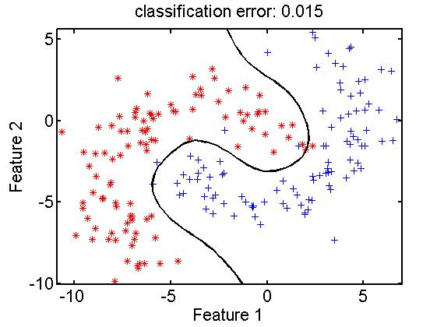
Transformation / Partition / Purity
Purity
Region - 1
Decision Boundary
Region - 2
Transformation

Slide 19
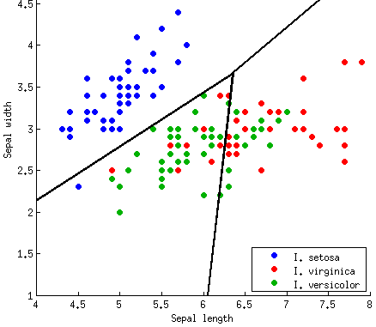
Decision boundary for 3-Class

Slide 20
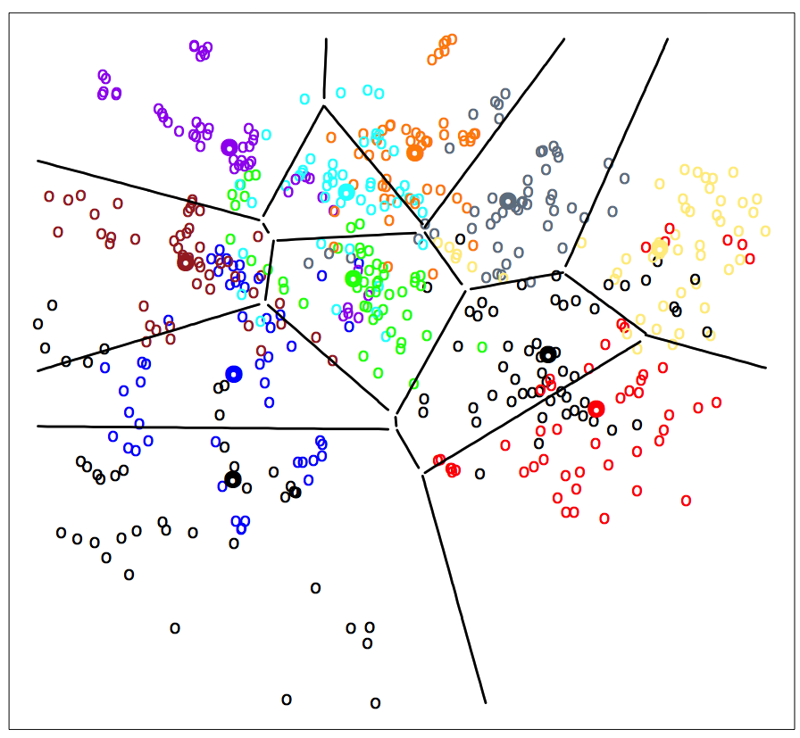
Decision Boundaries for multi-class

Slide 21
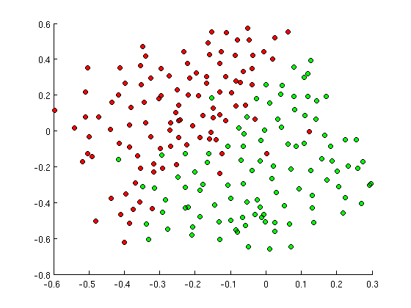
SIMPLE Decision Boundary?

Slide 22
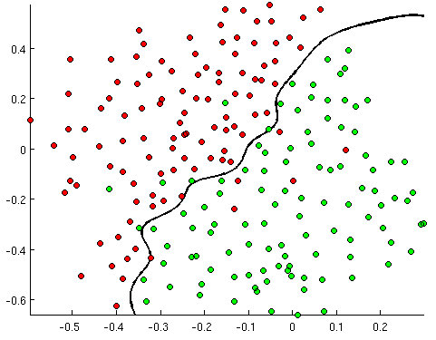
MEDIUM Decision Boundary!

Slide 23
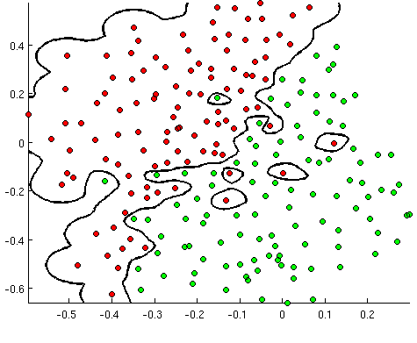
COMPLEX Decision Boundary!

Slide 24
Model SIGNAL not NOISE
Model is too simple → UNDER LEARN
Model is too complex → MEMORIZE
Model is just right → GENERALIZE

Slide 25
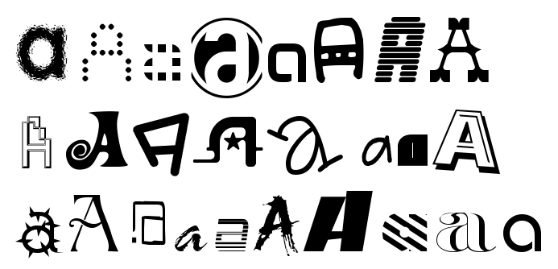
Generalization vs. Memorization
Generalization: The ability to predict or assign a label to a “new” observation based on the “model” built from past experience

Slide 26
Generalize, don’t Memorize!
Training Set Accuracy
Right Level of Model Complexity
Model Accuracy
Validation Set Accuracy
Model Complexity

Slide 27
Classification: Steps
Given a collection of records (training set )
Each record contains a set of attributes, one of the attributes is the class.
Task: Find a model for class attribute as a function of the values of other attributes.
Goal: previously unseen records should be assigned a class as accurately as possible.
A test set is used to determine the accuracy of the model. Usually, the given data set is divided into training and test sets, with training set used to build the model and test set used to validate it.

Slide 28
Illustrating Classification Task

Slide 29

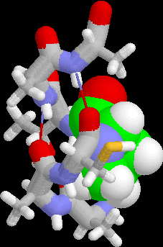
Examples of Classification Task
Predicting tumor cells as benign or malignant
Classifying credit card transactions as legitimate or fraudulent
Classifying secondary structures of protein as alpha-helix, beta-sheet, or random coil
Categorizing news stories as finance, weather, entertainment, sports, etc

Slide 30
Classification Techniques
Decision Tree based Methods
Neural Networks
Naïve Bayes and Bayesian Belief Networks
Support Vector Machines
…..
…..

Slide 31
Decision Tree

Slide 32
Example of a Decision Tree
categorical
categorical
continuous
class
Splitting Attributes
Refund
Yes
No
NO
MarSt
Single, Divorced
Married
TaxInc
NO
< 80K
> 80K
NO
YES
Training Data
Model: Decision Tree

Slide 33
Another Example of Decision Tree
categorical
categorical
continuous
class
MarSt
Single, Divorced
Married
NO
Refund
Yes
No
NO
TaxInc
< 80K
> 80K
NO
YES
There could be more than one tree that fits the same data!

Slide 34
Decision Tree Classification Task
Decision Tree

Slide 35
Apply Model to Test Data
Test Data
Start from the root of tree.
Refund
Yes
No
NO
MarSt
Single, Divorced
Married
TaxInc
NO
< 80K
> 80K
NO
YES

Slide 36
Apply Model to Test Data
Test Data
Refund
Yes
No
NO
MarSt
Single, Divorced
Married
TaxInc
NO
< 80K
> 80K
NO
YES

Slide 37
Apply Model to Test Data
Test Data
Refund
Yes
No
NO
MarSt
Single, Divorced
Married
TaxInc
NO
< 80K
> 80K
NO
YES

Slide 38
Apply Model to Test Data
Test Data
Refund
Yes
No
NO
MarSt
Single, Divorced
Married
TaxInc
NO
< 80K
> 80K
NO
YES

Slide 39
Apply Model to Test Data
Test Data
Refund
Yes
No
NO
MarSt
Single, Divorced
Married
TaxInc
NO
< 80K
> 80K
NO
YES

Slide 40
Apply Model to Test Data
Test Data
Refund
Yes
No
NO
MarSt
Single, Divorced
Married
Assign Cheat to “No”
TaxInc
NO
< 80K
> 80K
NO
YES

Slide 41
Decision Tree Classification Task
Decision Tree

Slide 42
C5.0

Slide 43
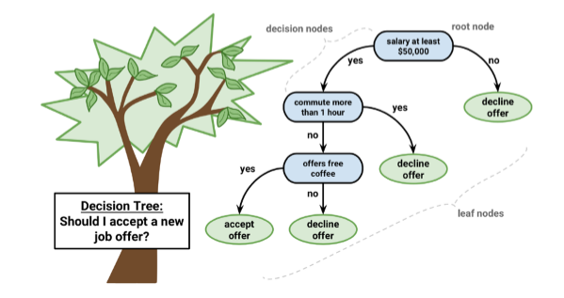
A job offer to be considered begins at the root node, where it is then passed through decision nodes that require choices to be made based on the attributes of the job. These choices split the data across branches that indicate potential outcomes of a decision, depicted here as yes or no outcomes,
though in some cases there may be more than two possibilities. In the case a final decision can be made, the tree is terminated by leaf nodes (also known as terminal nodes) that denote the action to be taken as the result of the series of decisions. In the case of a predictive model, the leaf nodes provide the expected result given the series of events in the tree.

Slide 44
Applications
• Credit scoring models in which the criteria that causes an applicant to be rejected need to be clearly documented and free from bias
• Marketing studies of customer behaviour such as satisfaction or churn, which will be shared with management or advertising agencies
• Diagnosis of medical conditions based on laboratory measurements, symptoms, or the rate of disease progression

Slide 45
Divide and conquer
Decision trees are built using a heuristic called recursive partitioning. This approach is also commonly known as divide and conquer because it splits the data into subsets, which are then split repeatedly into even smaller subsets, and so on and so forth until the process stops when the algorithm determines the data within the subsets are sufficiently homogenous, or another stopping criterion has been met.

Slide 46
How Decision Tree works
To see how splitting a dataset can create a decision tree, imagine a bare root node that will grow into a mature tree. At first, the root node represents the entire dataset, since no splitting has transpired. Next, the decision tree algorithm must choose a feature to split upon; ideally, it chooses the feature most predictive of the target class. The examples are then partitioned into groups according to the distinct values of this feature, and the first set of tree branches are formed

Slide 47
C5.0 is one of the best implementations of the Decision
Tree Building methodology:
The first question is which feature to select first?
There are various measures to identify the best decision tree splitting candidate.
C5.0 uses entropy, a concept borrowed from information theory that quantifies the randomness, or disorder, within a set of class values.
Data sets with high entropy are very diverse and provide little information about other items that may also belong in the set, as there is no apparent commonality.
The decision tree hopes to find splits that reduce entropy, ultimately increasing homogeneity within the groups.

Slide 48
How do you identify good features
My aim is to determine whether given ball is useful for playing.
Now,
Which are the above columns are most helpful to carryout above objective?

Slide 49
Can we quantify the usefulness of columns / Features?

Slide 50
Entropy of a Distribution
Consider a UNIVERSE of possible events (dice = {1, 2, …, 6})
Probability of an event:
Number of bits to transmit that event:
Expected Number of bits for all events?
The Entropy is the Expected Information Content of all events

Slide 51
In General..
How do we measure the information?
When something unexpected happens, we say it's a big news.
Also, when we say something easily predictable, it's not really interesting.
So to quantify this interesting-ness, the function should satisfy
if the probability of the event is 1 (predictable), then the function gives 0
if the probability of the event is close to 0, then the function should give high number
if probability 0.5 events happens it give one bit of information.
One natural measure that satisfy the constraints is I(X) = -log_2(p)
where p is the probability of the event X. And the unit is in bit, the same bit computer uses. 0 or 1.

Slide 52
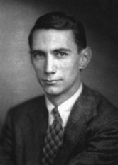
Information Theory 101
What is the “Information Content” of the following events?
The sun rose in the east today.
The weather in London is Cloudy.
A baby is born in my community.
A major earthquake hit LA.
The Information Content is proportional to RARITY.
Claude Elwood Shannon (1916–2001)

Slide 53

Entropy
Typically, entropy is measured in bits.
If there are only two possible classes, entropy values can range from 0 to 1.
For n classes, entropy ranges from 0 to log2(n).
Minimum value indicates that the sample is completely homogenous, while the maximum value indicates that the data are as diverse as possible, and no group has even a small plurality.
Entropy can be computed by
For a given segment of data (S), the term c refers to the number of class levels and pi refers to the proportion of values falling into class level i.

Slide 54
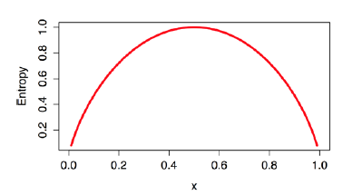
Entropy
Entropy for all the possible two-class arrangements.
As illustrated by the peak in entropy at x = 0.50, a 50-50 split results in maximum entropy. As one class increasingly dominates the other, the entropy reduces to zero

Slide 55

Information gain
To use entropy to determine the optimal feature to split upon, the algorithm calculates the change in homogeneity that would result from a split on each possible feature, which is a measure known as information gain.
The information gain for a feature F is calculated as the difference between the entropy in the segment before the split (S1) and the partitions resulting from the split (S2):
After splitting the feature , the function to calculate Entropy(S2) needs to consider the total entropy across all of the partitions
The total entropy resulting from a split is the sum of the entropy
of each of the n partitions weighted by the proportion of examples falling in the partition (wi)

Slide 56
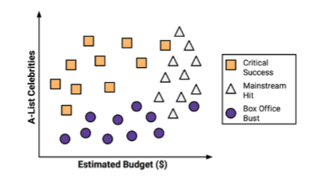
Example
Predict whether a potential movie would fall into one of three categories: Critical Success, Mainstream Hit, or Box Office Bust.
Relationship between the film's estimated shooting budget, the number of A-list celebrities lined up for starring roles, and the level of success.

Slide 57
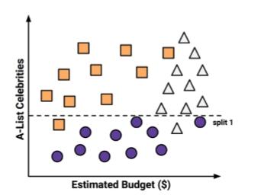
Using the divide and conquer strategy, we can build a simple decision tree from this data. First, to create the tree's root node, we split the feature indicating the number of celebrities, partitioning the movies into groups with and without a significant number of A-list stars:

Slide 58
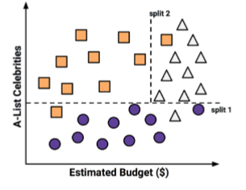
Next, among the group of movies with a larger number of celebrities, we can make another split between movies with and without a high budget:

Slide 59
The group at the top-left corner of the diagram is composed entirely of critically acclaimed films. This group is distinguished by a high number of celebrities and a relatively low budget. At the top-right corner, majority of movies are box office hits with high budgets and a large number of celebrities. The final group, which has little star power but budgets ranging from small to large, contains the flops.

Slide 60
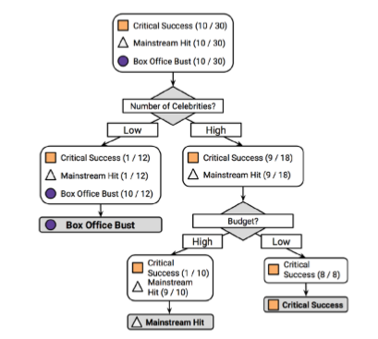

Slide 61
Pruning the decision tree
A decision tree can continue to grow indefinitely, choosing splitting features and dividing the data into smaller and smaller partitions until each example is perfectly classified or the algorithm runs out of features to split on. However, if the tree grows overly large, many of the decisions it makes will be overly specific and the model will be overfitted to the training data. The process of pruning a decision tree involves reducing its size such that it generalizes better to unseen data

Slide 62
Implementation of Decision Tree

Slide 63
Intro to Ensemble Methods

Slide 64
Intro : Ensemble methods
The accuracy and reliability of a predictive model can be boosted in two ways: Either by embracing feature engineering or by applying boosting algorithms straight away.
While working with boosting algorithms, you’ll soon come across two frequently occurring buzzwords: Bagging and Boosting
Bagging: It is an approach where you take random samples of data, build same learning algorithms and take simple means to find bagging probabilities.
Boosting: Boosting is similar, however the selection of sample is made more intelligently. We subsequently give more and more weight to hard to classify observations.

Slide 65
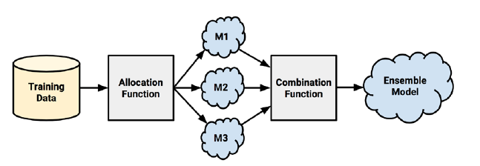
Understanding ensembles
Suppose you were a contestant on a television trivia show that allowed you to choose a panel of five friends to assist you with answering the final question for the million-dollar prize. Most people would try to stack the panel with a diverse set of subject matter experts. A panel containing professors of literature, science, history,and art, along with a current pop-culture expert would be a safely well-rounded group. Given their breadth of knowledge, it would be unlikely to find a question that stumps the group.
The meta-learning approach that utilizes a similar principle of creating a varied
team of experts is known as an ensemble. All the ensemble methods are based on the idea that by combining multiple weaker learners, a stronger learner is created.

Slide 66
First, input training data is used to build a number of models.
The allocation function dictates how much of the training data each model receives. Do they each receive the full training dataset or merely a sample? Do they each receive every feature or a subset?
After the models are constructed, they can be used to generate a set of predictions, which must be managed in some way.
The combination function governs how disagreements among the predictions are reconciled
For example, the ensemble might use a majority vote to determine the final prediction, or it could use a more
complex strategy such as weighting each model's votes based on its prior performance

Slide 67
Bagging
One of the first ensemble methods to gain widespread acceptance used a technique
called bootstrap aggregating or bagging for short
Bagging generates a number of training datasets by bootstrap sampling the original training data. These datasets are then used to generate a set of models using a single learning algorithm. The models' predictions are combined using voting (for classification) or averaging (for numeric prediction).
Although bagging is a relatively simple ensemble, it can perform quite well as long as it is used with relatively unstable learners, that is, those generating models that tend to change substantially when the input data changes only slightly. Unstable models are essential in order to ensure the ensemble's diversity in spite of only minor variations between the bootstrap training datasets. For this reason, bagging is often used with decision trees, which have the tendency to vary dramatically given minor changes in the input data.

Slide 68
Bootstrap Method
The bootstrap is a powerful statistical method for estimating a quantity from a data sample. This is easiest to understand if the quantity is a descriptive statistic such as a mean or a standard deviation
Let’s assume we have a sample of 100 values (x) and we’d like to get an estimate of the mean of the sample.
We can calculate the mean directly from the sample as:
mean(x) = 1/100 * sum(x)
We know that our sample is small and that our mean has error in it. We can improve the estimate of our mean using the bootstrap procedure:
Create many (e.g. 1000) random sub-samples of our dataset with replacement (meaning we can select the same value multiple times).
Calculate the mean of each sub-sample.
Calculate the average of all of our collected means and use that as our estimated mean for the data.

Slide 69
Let’s assume we have a sample dataset of 1000 instances (x) and we are using the C5.0 algorithm. Bagging of the C5.0 algorithm would work as follows.
Create many (e.g. 100) random sub-samples of our dataset with replacement.
Train a C5.0 model on each sample.
Given a new dataset, calculate the average prediction from each model.
For example,
if we had 5 bagged decision trees that made the following class predictions for a in input sample:
blue, blue, red, blue and red, we would take the most frequent class and predict blue

Slide 70
When bagging with decision trees, we are less concerned about individual trees overfitting the training data. For this reason and for efficiency, the individual decision trees are grown deep (e.g. few training samples at each leaf-node of the tree) and the trees are not pruned. These trees will have both high variance and low bias. These are important characterize of sub-models when combining predictions using bagging.
The only parameters when bagging decision trees is the number of samples and hence the number of trees to include. This can be chosen by increasing the number of trees on run after run until the accuracy begins to stop showing improvement (e.g. on a cross validation test harness). Very large numbers of models may take a long time to prepare, but will not over fit the training data
Practical R session on Bagged Tree

Slide 71
Boosting

Slide 72
Boosting is an ensemble technique that attempts to create a strong classifier from a number of weak classifiers
This is done by building a model from the training data, then creating a second model that attempts to correct the errors from the first model. Models are added until the training set is predicted perfectly or a maximum number of models are added.
AdaBoost was the first really successful boosting algorithm developed for binary classification and later on extended to multiclass problem. It is the best starting point for understanding boosting.
AdaBoost can be used to boost the performance of any machine learning algorithm. It is best used with weak learners. These are models that achieve accuracy just above random chance on a classification problem

Slide 73
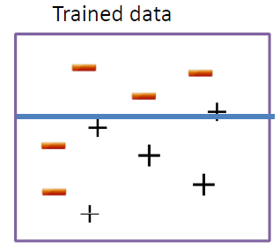
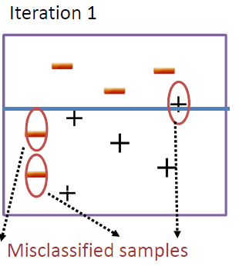
Algorithm
Samples difficult to classify receives increasingly larger weights until the algorithm identifies an algorithm that correctly classifies these samples
At each iteration, a stage weight [ln(1-err/err)] is computed based on the error rate at that iteration [ at the initial stage it assigns equal weights (1/N) to all observations ]
The overall sequence of weighted classifiers is then combined into an ensemble and has a strong potential to classify better than any of the individual classifiers

Slide 74
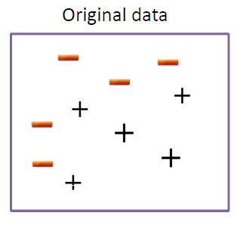
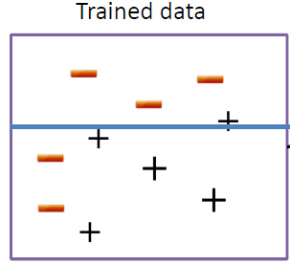
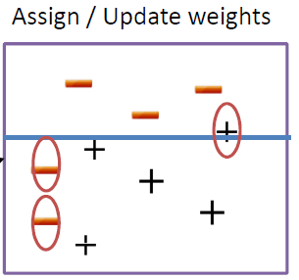
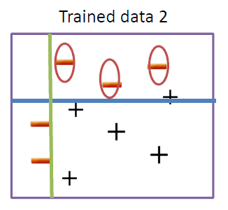
Samples that are incorrectly classified
in the kth iteration receives more weights in the (k+1)st iteration, while samples that are correctly classified receives less weights in subsequent iteration

Slide 75
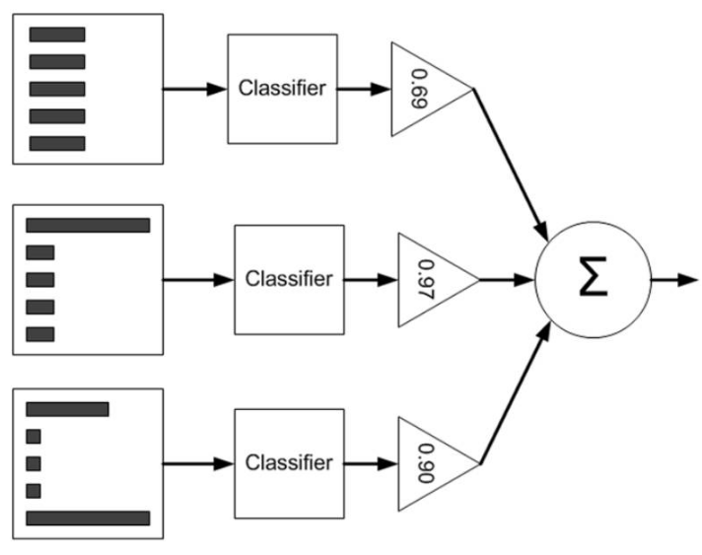
Learning An AdaBoost Model From Data
Output summarization
Each sample have the same starting weight (1/n) initially
Fit a weak classifier using the weighted samples and compute the kth model’s misclassification error (errk)
Compute the kth stage value as ln ((1 − errk) /errk)
Update the sample weights giving more weight to incorrectly predicted samples and less weight to correctly predicted samples

Slide 76


Where error is the mis classication rate, correct are the number of training instance predicted
correctly by the model and N is the total number of training instances. For example, if the
model predicted 78 of 100 training instances correctly the error or misclassication rate would
be 78-100 /100 or 0.22.
The above formula is modified to use the weightage of the training instances:

Slide 77

Which is the weighted sum of the misclassification rate, where w is the weight for training
instance i and perror is the prediction error for training instance i which is 1 if misclassified
and 0 if correctly classified.
For example, if we had 3 training instances with the weights 0.01, 0.5 and 0.2.
The predicted values were -1, -1 and -1, and the actual output variables in the instances were -1, 1 and -1, then the perror values would be 0, 1, and 0. The misclassification rate would be calculated as:

Slide 78


A stage value is calculated for the trained model which provides a weighting for any predictions
that the model makes. The stage value for a trained model is calculated as follows:
Where stage is the stage value used to weight predictions from the model, ln() is the natural
logarithm and error is the misclassification error for the model. The effect of the stage weight
is that more accurate models have more weight or contribution to the final prediction.
The training weights are updated giving more weight to incorrectly predicted instances, and less
weight to correctly predicted instances. For example, the weight of one training instance (w) is
updated using:

Slide 79
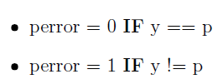
Where w is the weight for a specific training instance, e is the numerical constant Euler's
number raised to a power, stage is the misclassification rate for the weak classier and perror
is the error the weak classier made predicting the output variable for the training instance,
evaluated as:
Where y is the output variable for the training instance and p is the prediction from the weak
learner. This has the effect of not changing the weight if the training instance was classified
correctly and making the weight slightly larger if the weak learner misclassified the instance.

Slide 80
Adaboost Ensemble
Weak models are added sequentially, trained using the weighted training data. The process
continues until a pre-set number of weak learners have been created (a user parameter) or no
further improvement can be made on the training dataset. Once completed, you are left with a
pool of weak learners each with a stage value.

Slide 81
Stacking

Slide 82
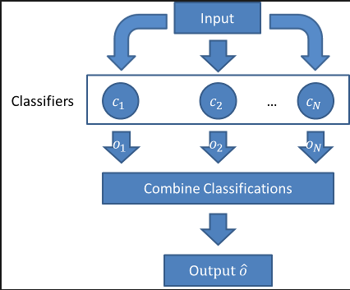
Stacking. Building multiple models (typically of differing types) and supervisor model that learns how to best combine the predictions of the primary models.

Slide 83
We can combine the predictions of multiple caret models using the caretEnsemble package.
Given a list of caret models, the caretStack() function can be used to specify a higher-order model to learn how to best combine the predictions of sub-models together.
Let’s first look at creating 5 sub-models for the ionosphere dataset, specifically:
Linear Discriminate Analysis (LDA)
Classification and Regression Trees (CART)
Logistic Regression (via Generalized Linear Model or GLM)
k-Nearest Neighbors (kNN)
Support Vector Machine with a Radial Basis Kernel Function (SVM)

Slide 84
When we combine the predictions of different models using stacking, it is desirable that the predictions made by the sub-models have low correlation. This would suggest that the models are skilful but in different ways, allowing a new classifier to figure out how to get the best from each model for an improved score.
If the predictions for the sub-models were highly corrected (>0.75) then they would be making the same or very similar predictions most of the time reducing the benefit of combining the prediction

Slide 85
Practical Issues of Classification
Under fitting and Overfitting
Class Imbalance

Slide 86
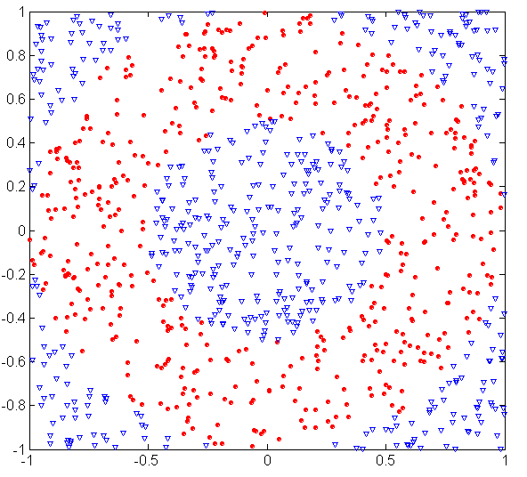
Underfitting and Overfitting (Example)
500 circular and 500 triangular data points.

Slide 87
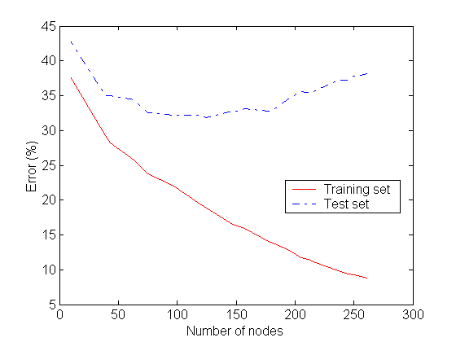
Underfitting and Overfitting
Overfitting
Underfitting: when model is too simple, and insufficient features would lead to both training and test errors are large

Slide 88
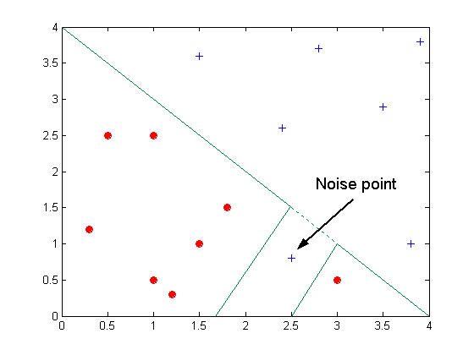
Overfitting due to Noise
Decision boundary is distorted by noise point

Slide 89
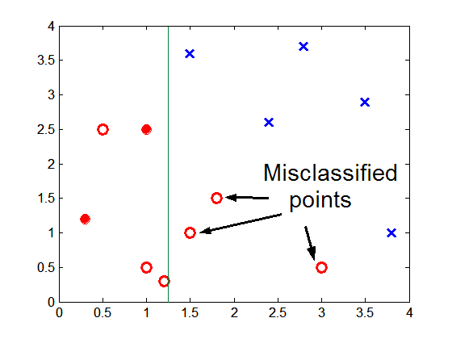
Overfitting
High complex model and Lack of data points in the lower half of the diagram makes it difficult to predict correctly the class labels of that region

Slide 90
Imbalance data set
What is Imbalanced Classification
Imbalanced classification is a supervised learning problem where one class outnumbers other class by a large proportion. This problem is faced more frequently in binary classification problems than multi-level classification problems
Below are the reasons which leads to reduction in accuracy of ML algorithms on imbalanced data sets:
ML algorithms struggle with accuracy because of the unequal distribution in dependent variable.
This causes the performance of existing classifiers to get biased towards majority class.
The algorithms are accuracy driven i.e. they aim to minimize the overall error to which the minority class contributes very little.
ML algorithms assume that the data set has balanced class distributions.
They also assume that errors obtained from different classes have same cost (explained below in detail).

Slide 91
Below are the methods used to treat imbalanced datasets:
Under sampling
Oversampling
Synthetic Data Generation
Under sampling
This method works with majority class. It reduces the number of observations from majority class to make the data set balanced. This method is best to use when the data set is huge and reducing the number of training samples helps to improve run time and storage troubles.
Oversampling
This method works with minority class. It replicates the observations from minority class to balance the data. It is also known as upsampling.

Slide 92
3. Synthetic Data Generation
In simple words, instead of replicating and adding the observations from the minority class, it overcome imbalances by generates artificial data. It is also a type of oversampling technique.
In regards to synthetic data generation, synthetic minority oversampling technique (SMOTE) is a powerful and widely used method. SMOTE algorithm creates artificial data based on feature space (rather than data space) similarities from minority samples. We can also say, it generates a random set of minority class observations to shift the classifier learning bias towards minority class.
To generate artificial data, it uses bootstrapping and k-nearest neighbors. Precisely, it works this way:
Take the difference between the feature vector (sample) under consideration and its nearest neighbor.
Multiply this difference by a random number between 0 and 1
Add it to the feature vector under consideration
This causes the selection of a random point along the line segment between two specific features

